Slide 1
Enthalpy l1
11 Chemistry

Slide 2
Learning objectives
• Identify that chemical reactions and phase changes involve energy changes, commonly observable as changes in the temperature or the surroundings and/or the emission of light.
• State that heat is a form of energy, and that temperature is a measure of the average kinetic energy of the particles.
• Explain how endothermic and exothermic reactions relate to the law of conservation of energy and the breaking and reforming of bonds.
• Discriminate between exothermic and endothermic reactions.

Slide 3
Signs of chemical reactions
Which of these are also signs of physical changes?
Change in temperature.
Light
Sound
Colour change.
Gas is produced (effervescence)
Energy is commonly released as heat, light, or sound.
Heat can also be absorbed to provide energy for the reaction.

Slide 4
Chemical reactions and energy
All chemical reactions involve an exchange of energy.
Energy is lost when chemical bonds form and is gained when chemical bonds break in a chemical reaction.
Enthalpy is a way to measure how much energy is lost or gained in a chemical reaction.

Slide 5
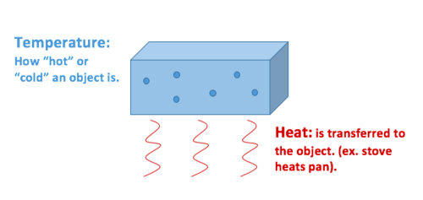
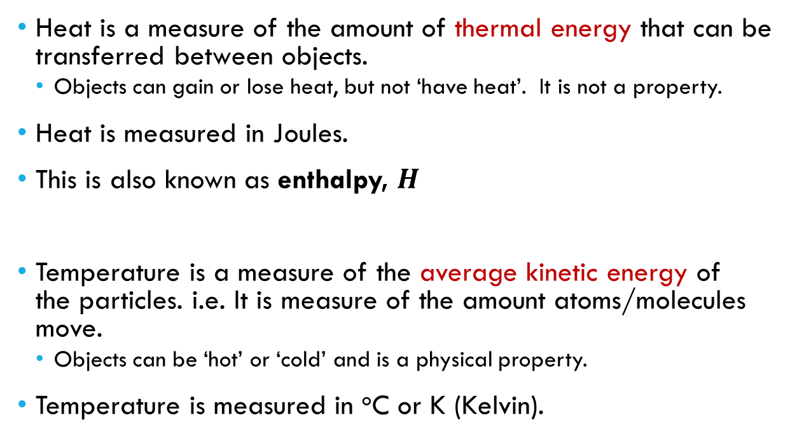
Heat vs temperature
Heat is a measure of the amount of thermal energy that can be transferred between objects.
Objects can gain or lose heat, but not ‘have heat’. It is not a property.
Heat is measured in Joules.
This is also known as enthalpy, $H$
Temperature is a measure of the average kinetic energy of the particles. i.e. It is measure of the amount atoms/molecules move.
Objects can be ‘hot’ or ‘cold’ and is a physical property.
Temperature is measured in ºC or K (Kelvin).

Slide 6
enthalpy
Enthalpy is energy lost or gained as heat.
Enthalpy is represented in mathematical equations as ‘H’.
The change in enthalpy of a reaction can be calculated*:
ΔH = H_{products} – H_{reactants}
*We will come back to this later.

Slide 7
Law of conservation of energy
Energy cannot be created or destroyed, but instead can be:
Transferred – move from one substance to another.
e.g. Chemical potential energy is transferred from one substance to another during a chemical reaction.
Transformed – change from one type of energy into another type of energy.
e.g. Chemical potential energy is transformed into heat energy.
Energy from a reaction could be observed as heat, light, or sound.

Slide 8
Endothermic vs exothermic reactions
Endothermic – net absorption of energy
Products have more stored energy than the reactants.
Heat is absorbed from the surroundings.
Exothermic – net release of energy
Reactants have more stored energy than the products.
Heat is released to the surroundings.

Slide 9
Endothermic reactions
Energy is absorbed from the surroundings.
You would experience this as the reaction feeling cold because the reaction is using up heat energy from the surroundings.
Can you think of any reactions where energy is absorbed?

Slide 10
Endothermic reactions
Energy is released to the surroundings.
You would experience this as the reaction feeling hot because the reaction is releasing heat energy to the surroundings.
Energy could also be released as light or sound.
Can you think of any reactions where energy is released?

Slide 11
Check for understanding
Explain how exothermic reactions relate to the Law of Conservation of Energy.
Explain how endothermic reactions relate to the breaking and forming of chemical bonds.

